Slide 1
Mass media
and popular culture

Slide 2
Media and pop culture
Society often distrusts and ridicules popular culture.
The “vast wasteland” of entertainment television, as FCC chair Newton Minow famously said in 1961.
Many people feel television, in particular, should be less about entertainment, and more about culturally significant programming.
What should be the role of television in a democracy? An ethical debate.

Slide 3
Media and pop culture
The material we as media practitioners choose to distribute reflects what we believe our world to be.
It also affects the world views of those who receive it.
What we show tells about what kind of society we are—the ethical dilemma is how we choose to reflect this.

Slide 4
Media and pop culture
But as we’ve said before, nearly all United States media is operated as for-profit companies.
Therefore, to make money, some content must appeal to an audience looking for escape in trivial and forgettable programming.
But profit maximizing does produce an ethical conflict with serious artists and producers who want to maintain their integrity.

Slide 5
Media and pop culture
Certainly, on the other hand, popular programming can have socially redeeming qualities—even though it’s not exactly Shakespeare.
Critically acclaimed programming sometimes also is popular.
But a lot of sensationalistic and escapist material is also out there. Some people fear the bad will drive out the good.

Slide 6
Media and pop culture
Those who support the sensationalism dismiss their critics as “elitist eggheads.” They cite the mass appeal of high ratings.
But just because a large audience watches this material, does that make it an okay ethical choice for producers?
Is it always the job of media to give people what they want, as opposed to what is important?
Or do we end up marginalizing the media as conduits of gossip and scandal?

Slide 7
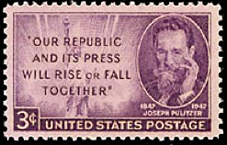
Media and pop culture
Gossip as news has historically been popular.
Joseph Pulitzer at the end of the nineteenth century said his sensational New York World could use this material as a way to attract readers to pages of real, important, and significant news.

Slide 8
Media and pop culture
Henry David Thoreau in 1863 made a comment about sensationalistic news:
“I am sure that I never read any memorable news in a newspaper. If we read of one man robbed, murdered, or killed by accident, or one house burned, or one vessel wrecked, or one steamboat blown up, or one cow run over on the Western Railroad, or one mad dog killed, or one lot of grasshoppers in the winter—we never need read of another. One is enough. If you are acquainted with the principle, what do you care for myriad instances and applications? To a philosopher, all ‘news’ as it is called, is gossip, and they who edit and read it are old women over their tea.”

Slide 9
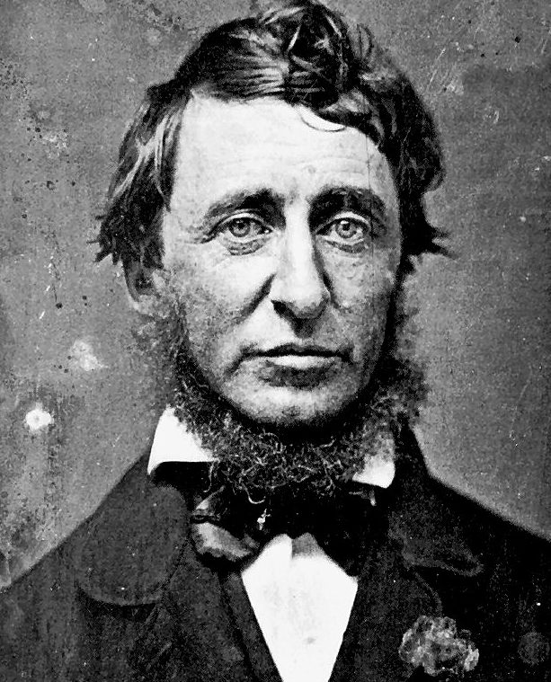
Media and pop culture
Despite Thoreau’s cynicism, the Penny Press of the time did have some significant news.
There seems to be nothing really wrong with being entertaining.

Slide 10
Media and pop culture
Some criticize TV news because, through its editing techniques, it presents events as if they were a lot more dramatic and entertaining than in real life.
But maybe real life is pretty dramatic and entertaining, but we become used to it and so take it for granted.
Still, the underlying serious of the news itself shouldn’t be overlooked, it seems.

Slide 11
Media and pop culture
Television news is a product, manufactured through the media-making process from events of the day.
It competes with all the other media products and all the other media.
Still, we might find an ethical question in whether it should be packaged as just another part of the world of entertainment, this is trivializing, sensationalizing, distorting or deceiving, or ignoring society’s real problems.

Slide 12
Media and pop culture
What damage might such an approach cause? Perhaps that people will miss important stories.
For example, in 1914 France media were so obsessed with covering a sensational murder trial that they completely missed growing danger of world war—until it was too late to debate about it and pressure politicians.
In summer 2001 the media were preoccupied with shark attacks. Did they miss the dangers of terrorist attack?

Slide 13
Media and pop culture
This is what can happen when news is entertainment—it’s more than a trivial question.
Pop culture revolves around the debate over “what is art?”
But in 1948 one possible definition was established:

Slide 14
Media and pop culture
Fine art is classical art, produced mostly by artists for their own satisfaction, little thought to prp8ulr appeal or commercial value.
In the past, fine art was only of concern to the aristocracy.
Most people could hardly afford to be a patron of the arts.
It was society’s elite who indulged in such aesthetic tastes, and they had high standards.

Slide 15
Media and pop culture
Folk art is usually defined as material and focus produced by an entire culture for a purpose—as a ritual, social, or practical thing. The opposite end of fine art. Folk art was produced and consumed by the masses,
Country music was once an expression of folk art, but now has been popularized by the mass media.
Classical music, on the other hand, was traditionally for the elites, considered fine art.

Slide 16
Media and pop culture
Popular art (pop art) draws its content from both fine art and folk art, but its mission is primarily commercial.
Pop art defines its success on the size of its audience or volume of profits.
This is the mainstay of the mass media, to respond to great demand for popular art.
Its function is to gather a large audience, so usually the lowest common denominator is attempted.

Slide 17
Media and pop culture
Mass media are the basic purveyors of popular art. But some supporters say they raise aesthetic tastes in society through popularization of fine art.
For example, a miniseries based on a classic novel, or popular classic music like the “Nutcracker.”
Elites probably don’t like the fact that mass audiences prefer popular works instead of those that have loftier goals.
But entertainment people reply, “We’re just giving people what they want.”

Slide 18
Media and pop culture
Why should mass media provide other, if their audiences are not demanding it?
But some ethics philosophers would call this reductionism: generalizing about a huge universe of media, which covers diverse artistic tastes.
All of us watch or read escapist pop culture from time to time.
The problem, critics say: so much escape that it distracts people from social participation, allows them to withdraw from reality.

Slide 19
Media and pop culture
Other critics say it is wrong for people to get so dependent on mass media for entertainment that they are no longer to entertain themselves.
They become permanent spectators of mass media.
You can test yourself on this with a “no media” project: try to eliminate media from your life for a few days.
Are you addicted to mass media?

Slide 20
Media and pop culture
Critics also say sensationalized and trivialized presentation of serious issues undermines society’s attempt to cope with those problems.
When the media reduce major issues of society to slogans, sound bites and stereotypes, does it damage democratic values of informed participation?

Slide 21
Media and pop culture
The market, of course, often decides. Media are in business to make money.
But don’t media practitioners have some responsibility to consider these critics and their comments?
Should commercialism be the sole driving force behind American popular media?

